Slide 1
Hospital Management System

Slide 2
Languages and Technologies used
1. HTML5/CSS3
2. JavaScript (to create dynamically updating content)
3. Bootstrap (An HTML, CSS, and JS library)
4. MAMP
5. Php
6. MySQL (An RDBMS that uses SQL)

Slide 3
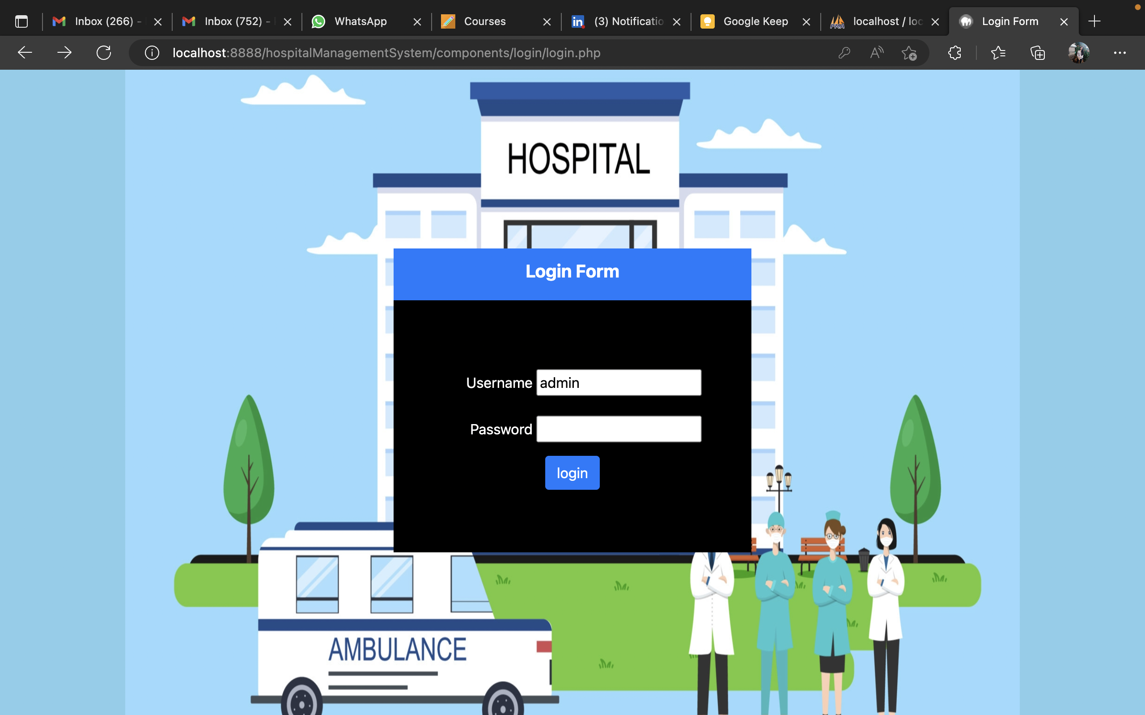
Login page
Login as admin, doctor, patient
The ‘Home’ page consists of:
1. About Hospital
2. Doctors Information
3. Department Information
4. Login

Slide 4
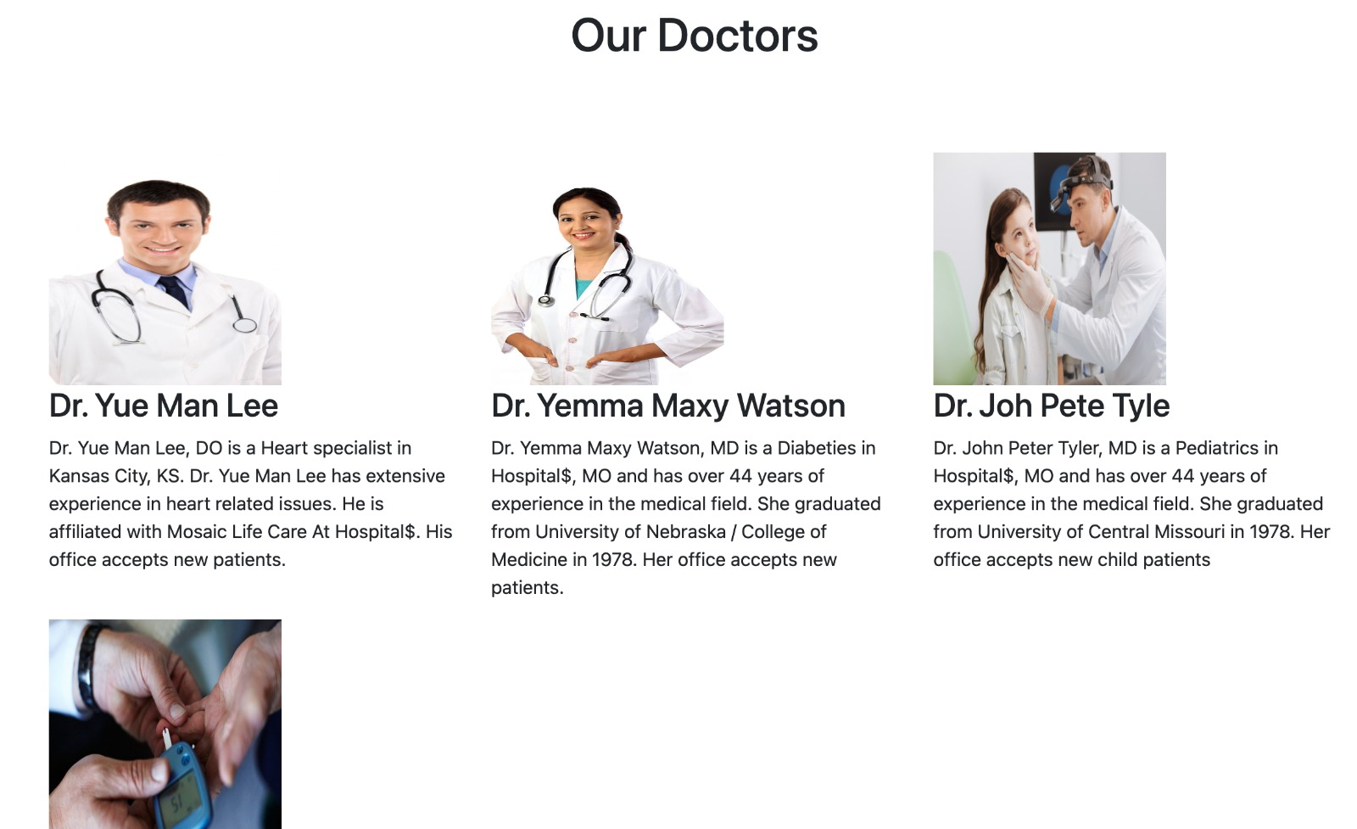

Departments, Doctors List

Slide 5
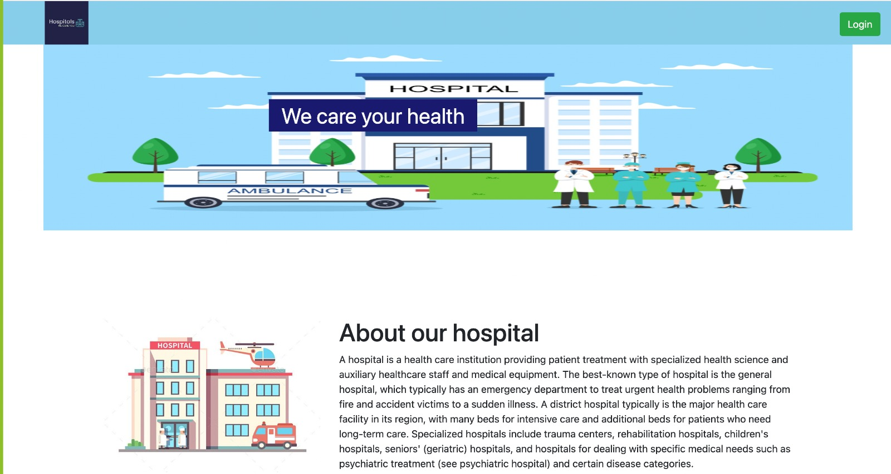
About page
Information about the Hospital

Slide 6
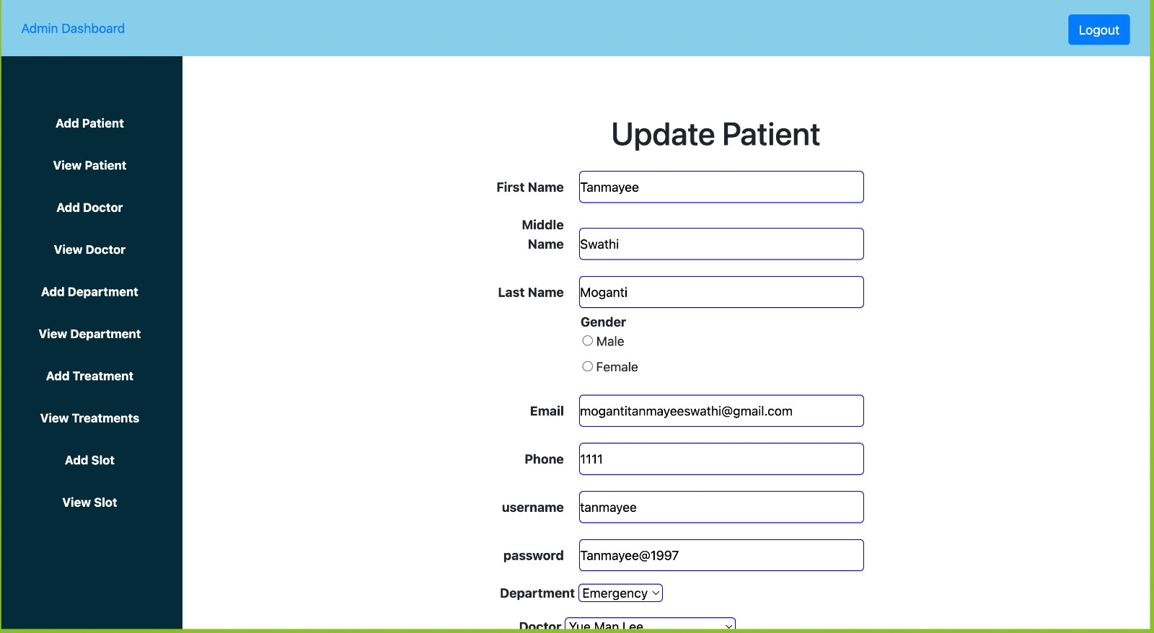
Admin Dashboard:
Admin can login and can create administrative work on below operations:
1. Add
2. View
3. Update
4. Delete
for below fields:
1. Patient
2. Doctor
3. Department
4. Treatment
5. Appointment Slot

Slide 7
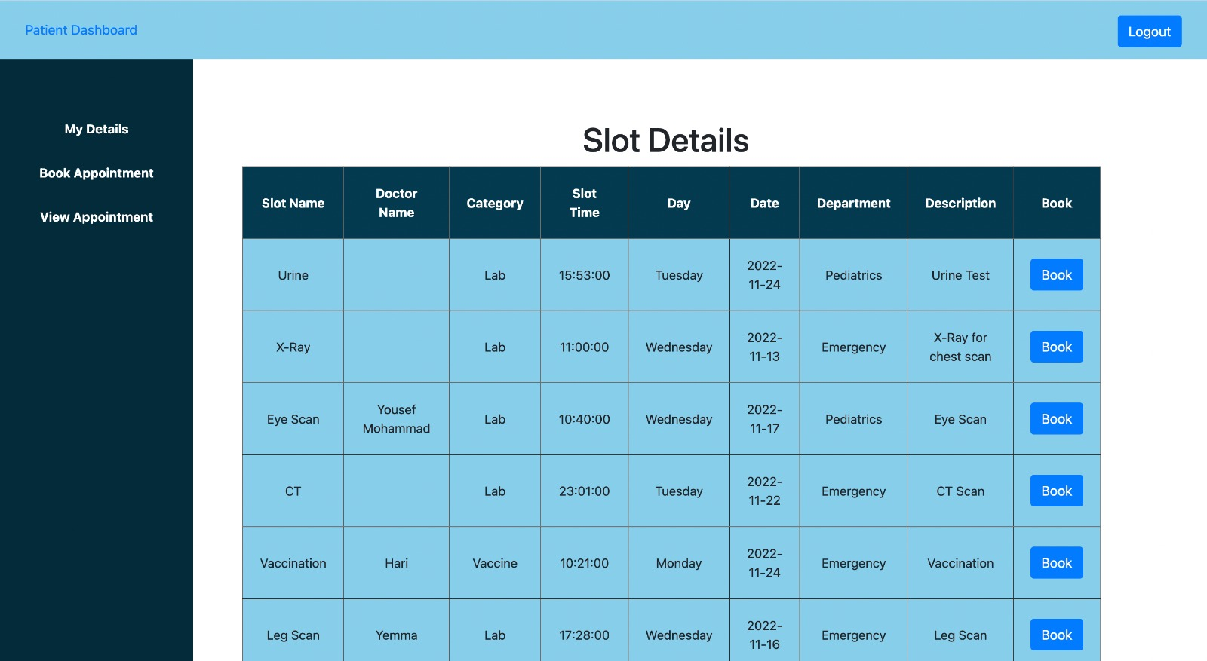
Patient Dashboard:
Patient dashboard have below fields:
1. Patient Profile Details
2. Make and Appointment
3. View Appointment

Slide 8
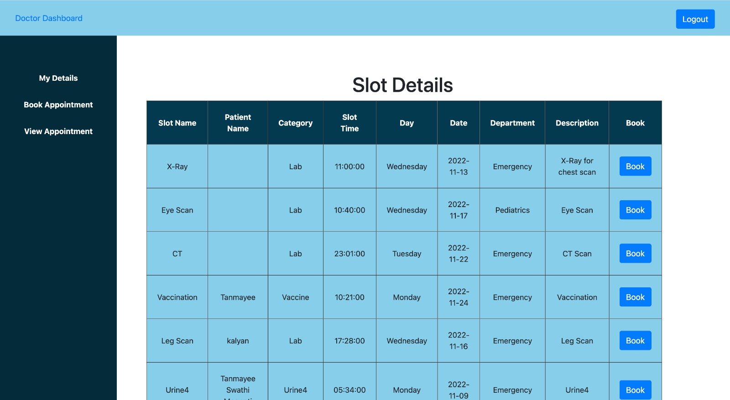
Doctor Dashboard:
Doctor dashboard have below fields:
1. Doctor Profile Detials
2. Make and Apointment
3. View Appointment

Slide 9
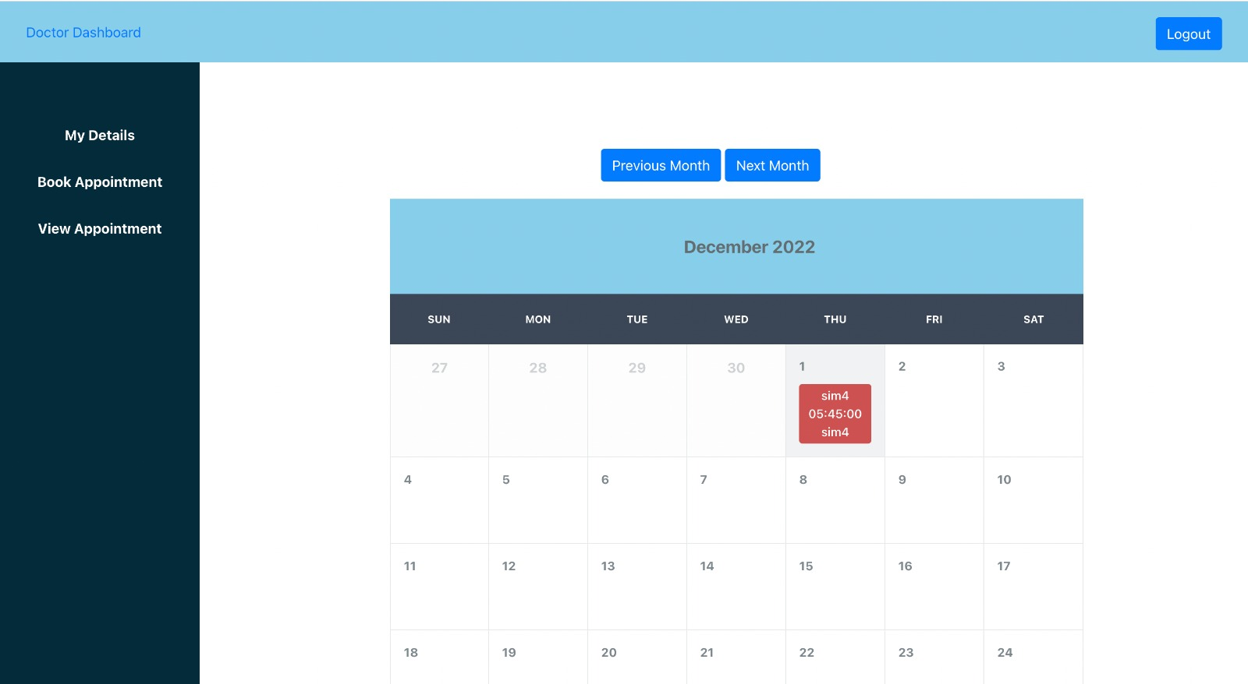
Doctor Dashboard

Slide 10
Doctor page
Doctor page has
My details
Book Appointment
View appointment features

Slide 11
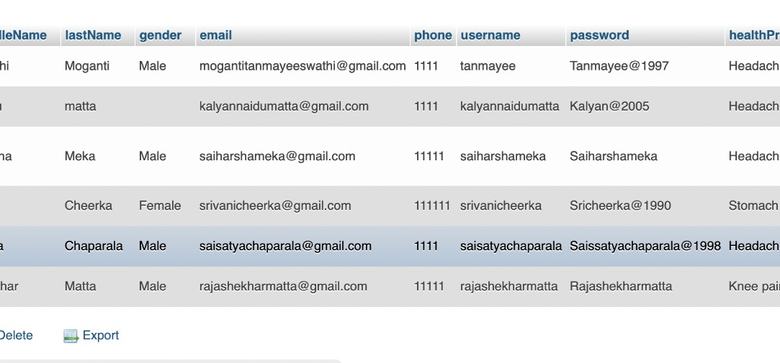
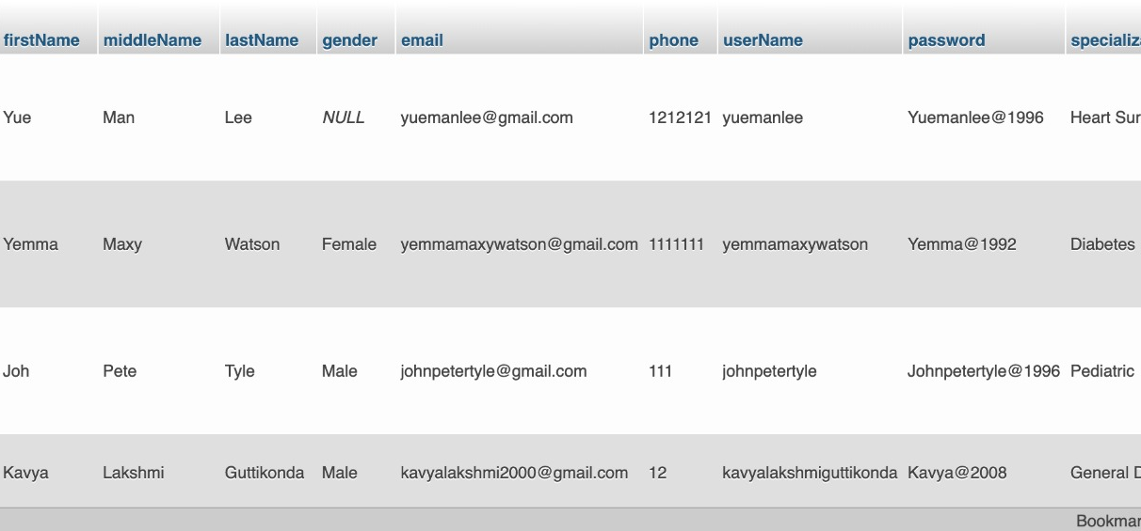
Doctor page

Slide 12

The End

